Slide 1





Stock Market Analysis
Name: Arpita Kadtane
Email Id: arpitakadtane@gmail.com
Guide: Vignesh M
Disclaimer: The content is curated for educational purposes only.
Notes:
Slides: Prepare a short slide deck (10-12 slides) summarizing the project objectives, methodology, and key results.

Slide 2
OUTLINE
Abstract of the Project
Problem Statement
Proposed Solution
System Architecture
Live Demo of the Project
Embedded Video of Project
Conclusion
Future Scope

Slide 3
Abstract The stock market is a dynamic and volatile environment where data-driven insights play a crucial role in decision-making. This project focuses on analyzing stock market trends using historical price data, statistical methods, and technical indicators. Key steps include data preprocessing, exploratory data analysis, feature engineering, and visualization of price movements through line charts, candlestick patterns, and correlation heatmaps. Moving averages, Bollinger Bands, RSI, and MACD were utilized to understand market momentum and volatility. The analysis provides valuable insights into market behavior, helping investors and traders make informed decisions.

Slide 4
Problem Statement The stock market is highly volatile, making it challenging for investors and traders to predict price movements and make informed decisions. Traditional analysis methods often fail to capture complex market trends, leading to uncertainty and financial risk. This project aims to leverage data analytics techniques to analyze stock price trends, identify patterns, and extract meaningful insights using statistical and technical indicators. By implementing data visualization, feature engineering, and predictive analysis, this study helps in understanding market behavior, improving investment strategies, and reducing uncertainty in stock trading decisions.

Slide 5
Proposed Solution 🔹 Data Collection & Preprocessing – Acquiring historical stock data, handling missing values, and formatting data for analysis. 🔹 Exploratory Data Analysis (EDA) – Visualizing stock price trends, return distributions, and correlations to uncover insights. 🔹 Technical Indicators Calculation – Implementing moving averages (SMA, EMA), RSI, MACD, and Bollinger Bands to analyze market momentum and volatility. 🔹 Data Visualization – Using line plots, candlestick charts, histograms, and heatmaps to understand price movements. 🔹 Feature Engineering – Creating lag features and other predictive variables to enhance market trend analysis. By integrating these techniques, the project provides valuable insights for investors and traders, helping them make data-driven investment decisions with reduced risk.

Slide 6
System Architecture 1. Data Collection Acquire historical stock price data from sources like Yahoo Finance, Alpha Vantage, or CSV files. 2. Data Preprocessing Handle missing values, convert date formats, normalize data, and prepare it for analysis. 3. Exploratory Data Analysis (EDA) Visualize stock price trends, return distributions, and correlations using heatmaps and histograms. 4. Feature Engineering Compute technical indicators such as SMA, EMA, RSI, MACD, Bollinger Bands, and create lag features. 5.Data Visualization Generate line plots, candlestick charts, histograms, and heatmaps for trend analysis.

Slide 7
Live Demo of Project GitHub Link: https://github.com/ArpitaKadtane/TechSaksham_Microsoft_Training/tree/main/MiniProject_StockMarketing

Slide 8
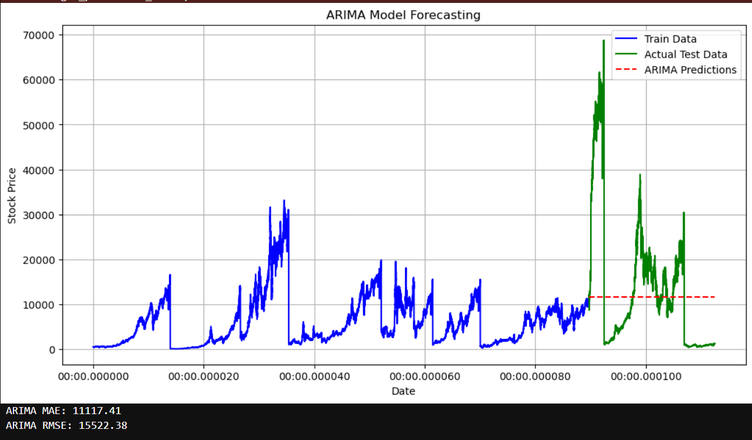
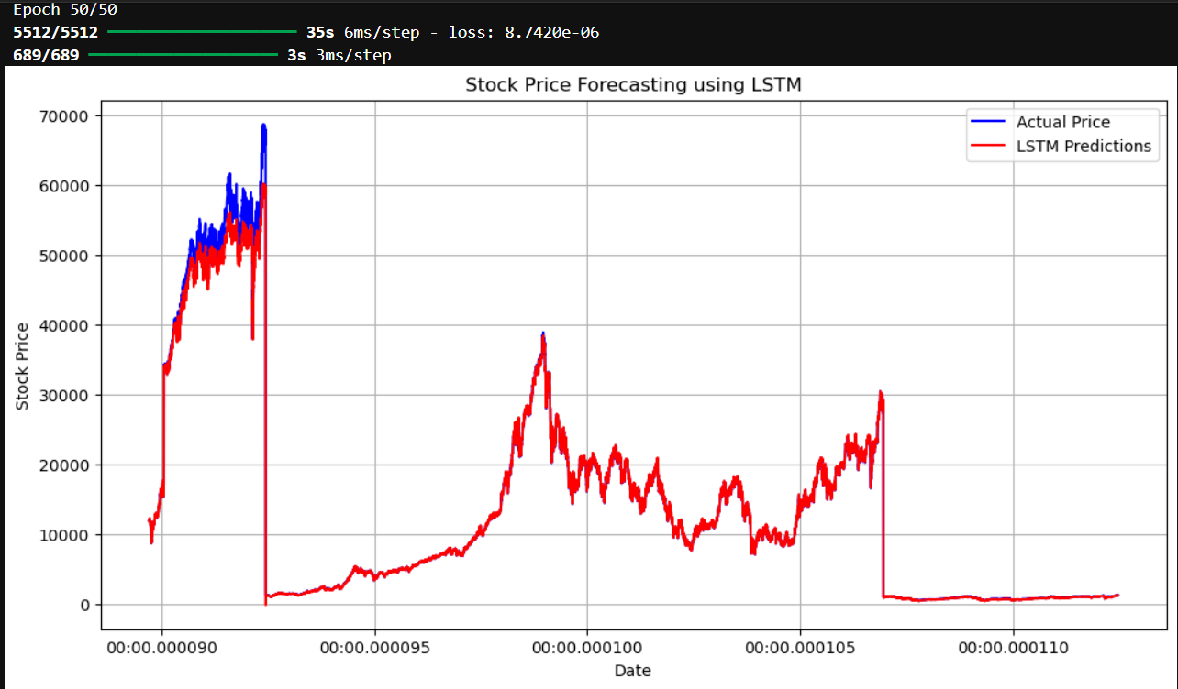
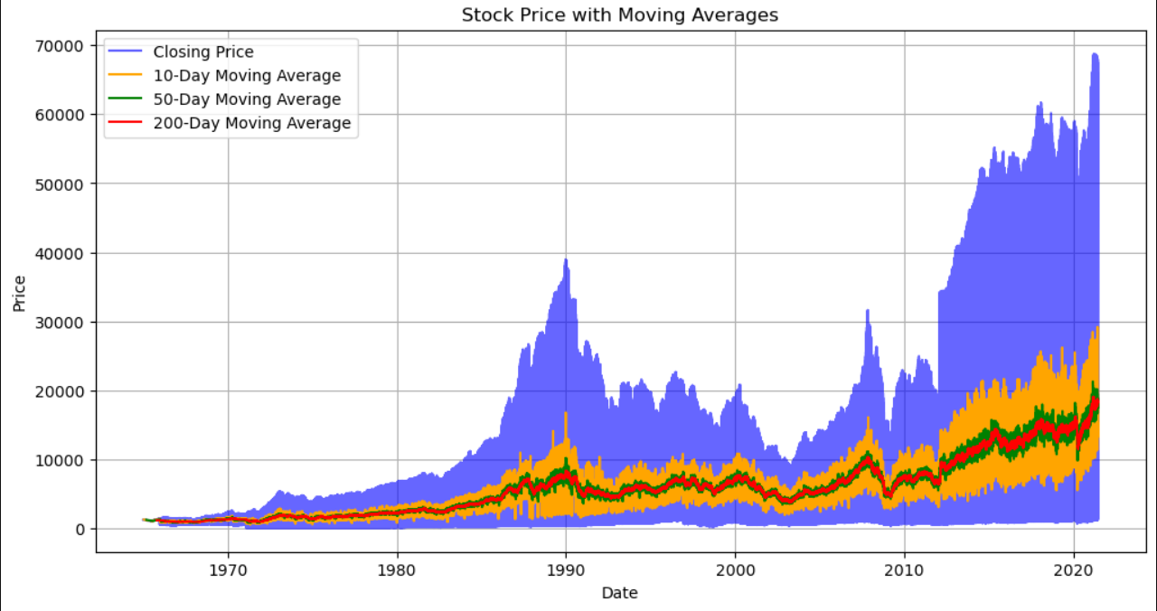
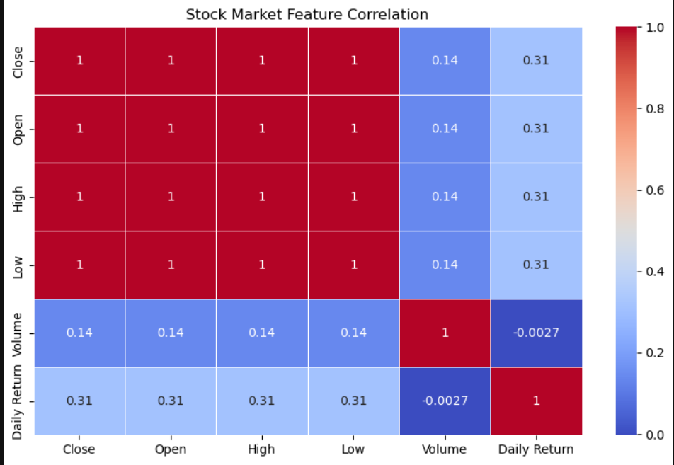
Video of Project Demo

Slide 9
Conclusion This project highlights the effectiveness of data analytics in understanding stock market trends and assisting investors in making informed decisions. By analyzing historical stock data, visualizing price movements, and applying technical indicators such as SMA, EMA, RSI, MACD, and Bollinger Bands, we gained meaningful insights into market behavior, volatility, and momentum. The integration of feature engineering further enhanced the dataset, providing deeper analytical perspectives. This approach helps traders identify patterns, assess risks, and optimize their investment strategies. Looking ahead, incorporating machine learning for price prediction, real-time data analysis, and automated trading strategies could further enhance the accuracy and applicability of stock market forecasting, making financial decision-making more data-driven and efficient.

Slide 10
Future Scope The future scope of this project extends beyond basic stock market analysis by integrating advanced technologies and real-time data processing. Incorporating machine learning and AI-driven models such as LSTMs, ARIMA, and deep learning can enhance stock price predictions with greater accuracy. Additionally, real-time data analysis using APIs will enable dynamic market tracking and instant decision-making. The development of automated trading systems powered by AI can further optimize trading strategies by executing buy/sell orders based on technical indicators and market conditions. Moreover, sentiment analysis through NLP can be leveraged to assess financial news, social media trends, and investor sentiment, helping predict potential market movements. Portfolio optimization techniques can also be applied to balance risk and maximize returns. These advancements will transform the project into a powerful financial analytics tool, enabling smarter investment strategies and minimizing risks in stock trading.

Slide 11
Thank you!
Notes:
thank you very much for joining this PPT, keep learning.
11

